Slide 1
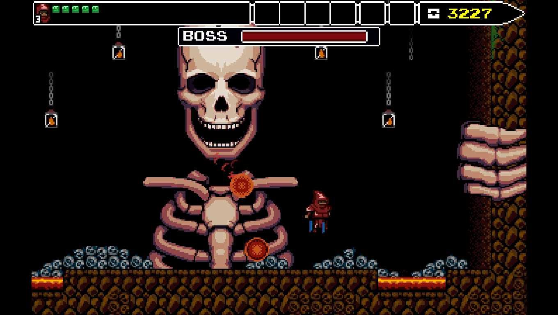
GAME PROGRAMMING
Week 6 — Lectures 11 & 12
Cameras · Levels · UI · Audio · Code Architecture
Course Material — Spring 2026

Slide 2
LECTURE OVERVIEW
Contents
01 Cameras: Framing the Action
05 Audio & Music
02 Level Setup: Environment Sprites
06 Adding More Levels
03 Game Loop: Management & UI
07 Code Basics & Architecture
04 In-Game UI & Main Menu
{ }

Slide 3
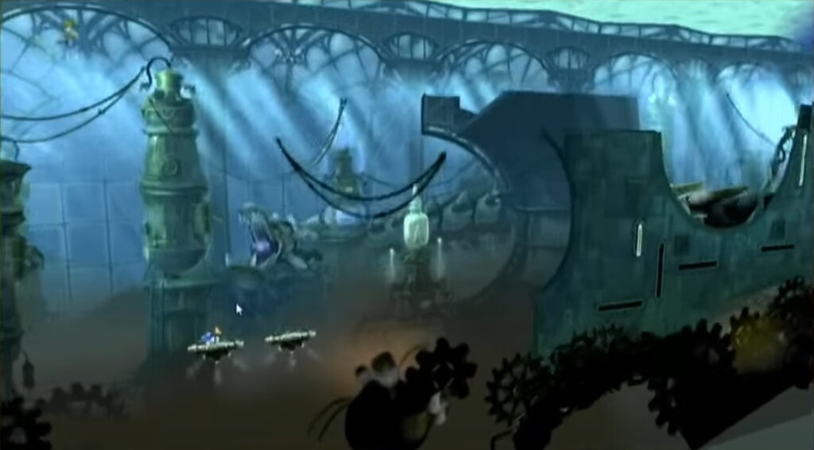
01
CAMERAS
Framing the Action
How camera systems guide player focus and create dynamic gameplay experiences

Slide 4
Why Camera Systems Matter
The camera is the player's window into the game world. A well-designed camera ensures the player always sees what matters.
Framing Action
Information Flow
Keep the subject centered and visible
Control what the player sees
Scale & Perspective
Cinematic Moments
Establish world size and spatial relationships
Create emotional impact
Poor camera design leads to player frustration, disorientation, and broken game flow. The camera is not decoration — it is a core gameplay system.
04

Slide 5
Common 2D Camera Types
01
02
03
04
Static Camera
Follow Camera
Bounded Camera
Multi-Target
Fixed position, never moves. Used in puzzle games, classic arcade, and scenes where the entire play area must be visible at once.
Tracks player movement with smooth interpolation. Most common in platformers and action games. Creates a sense of forward momentum.
Follows player but clamped to level boundaries. Prevents showing areas outside the designed world. Essential for contained levels.
Frames multiple points of interest. Used in co-op games and arena fighters. Calculates bounding box of all targets and frames them.
Design Tip: Most games combine camera types. A platformer might use Follow Camera during gameplay, then switch to Static for boss introductions, and Multi-Target during co-op sections.
05

Slide 6
Camera Follow with Smoothing
Raw camera following creates jarring motion. Smooth follow uses linear interpolation (lerp) for a polished feel.
Smooth Follow Visualization
camera.pos = Lerp(current, target, followSpeed × deltaTime)
Viewport
Player
Dead Zone
Smoothing Techniques
lookahead
Lookahead — Camera leads player movement, showing more of where they're going
Damping — Different smoothness per axis. Vertical needs more damping
Dead Zone — Player can move within area without camera following
06

Slide 7
Camera Bounds & Clamping
Implementation Steps
Clamping Visualization
1
Define level bounds: minX, maxX, minY, maxY
Level Bounds
2
Calculate camera half-size from viewport dimensions
3
Clamp camera position to valid bounds
Camera View
4
Apply smoothing after clamping for clean motion
float halfW = camera.viewportWidth / 2;
float clampedX = Mathf.Clamp(targetX,
minX + halfW, maxX - halfW);
camera.position.x = Mathf.Lerp(
camera.position.x, clampedX, speed);
minX
maxX
07

Slide 8
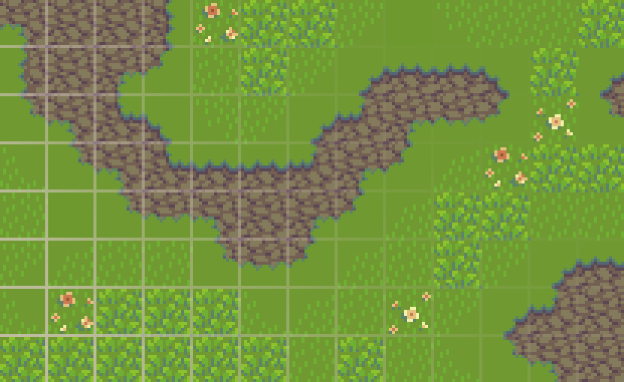
02
LEVEL SETUP
Environment Sprites
Building immersive game worlds through tilemaps, layering, and parallax effects

Slide 9
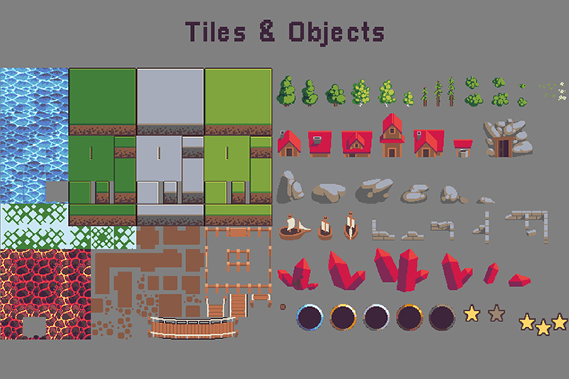
Sprite-Based Environments
2D game environments are built from sprite assets organized into cohesive scenes. Four key components work together:
Tilemaps
Grid-based systems for placing repeating terrain tiles
Sprite Atlases
Combined texture sheets reducing draw calls
Environment Props
Decorative sprites adding visual detail and atmosphere
Collision Tiles
Example: Tileset with terrain, props, and objects
Invisible geometry defining walkable boundaries
A well-organized sprite pipeline is essential for scalable level design.
09

Slide 10
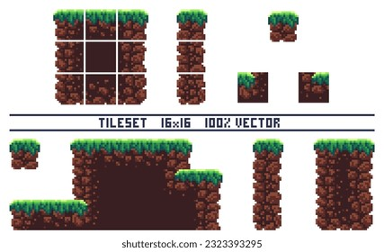
Tilemap Systems & Layers
Ground Layer
Walkable surfaces and base terrain — the foundation of the level
Decoration Layer
Visual details like grass, rocks, flowers — no collision
Collision Layer
Invisible boundaries and platform geometry — defines physics
Foreground Layer
Elements drawn in front of player for depth and atmosphere
Modern engines provide built-in tilemap editors with auto-tiling, brush tools, and tile rule systems for rapid level construction.
10

Slide 11
Sorting Order & Layer Depth
Three mechanisms control sprite rendering order in 2D games:
Sorting Layers
Order in Layer
Transform Z-Position
Named groups rendered in sequence: Background → Midground → Foreground. Each layer is a render pass.
Numeric priority within each layer. Higher numbers render on top. Controls overlap within the same layer.
Depth along the Z-axis for pseudo-3D effects. Useful for isometric and top-down perspective games.
Best Practice
In top-down games, set character Order in Layer based on Y-position (bottom-screen sprites first). This creates natural depth: order = -(int)(transform.position.y * 100)
Proper sorting prevents visual glitches like characters walking behind objects they should be in front of.
11

Slide 12

Parallax Background Scrolling
Parallax creates depth illusion by moving background layers at different speeds. Each layer has a parallax factor (0.0 to 1.0).
layerOffset = cameraPosition × parallaxFactor
Typical Parallax Factors
Layer Type | Factor | Examples
Background (sky) | 0.1 - 0.3 | Clouds, stars, moon
Midground | 0.4 - 0.6 | Mountains, buildings
Gameplay Layer | 1.0 | Ground, player, enemies
The Result
Rich visual depth that makes 2D worlds feel expansive and immersive.
12

Slide 13

03
GAME LOOP
Management & UI
Architecting game state, managers, and the event-driven UI system

Slide 14
Game Manager Architecture
Game Managers are singleton-pattern controllers coordinating global systems:
GameManager
ScoreManager
UIManager
High-level game state: playing, paused, game over
Tracks and persists player score and achievements
Controls UI panels, transitions, and input routing
AudioManager
LevelManager
Manages sound playback and music transitions
Handles scene loading and level progression
Using a manager pattern prevents spaghetti code and creates clean separation of concerns. Each manager has a single responsibility and communicates through events.
14

Slide 15
Game States & State Machine
Games operate as finite state machines with clear state transitions. Each state has defined entry/exit behaviors.
MainMenu
Playing
Paused
GameOver
LevelComplete
Implementation Pattern
public enum GameState {
MainMenu, Playing, Paused,
GameOver, LevelComplete }
void ChangeState(GameState s) {
current.OnExit(); current = s;
current.OnEnter(); }
1. Use an enum for state definitions
2. State change method calls OnExit() on old state and OnEnter() on new state
3. Update logic runs only the current state's behavior
15

Slide 16
UI Canvas & Event System
Canvas Render Modes
Screen Space - Overlay
Screen Space - Camera
World Space
Renders on top of everything. Most common for HUDs and menus.
Positioned relative to a camera. UI can be occluded by world objects.
Placed in the 3D scene. Used for in-world UI like nameplates and signs.
Event System Components
Graphic Raycaster
Input Module
Event Trigger
Detects clicks on UI elements
Handles mouse, keyboard, touch
Defines responses to pointer events
Canvas Scaling Modes
Constant Pixel Size — UI stays same size in pixels regardless of resolution.
Scale With Screen Size — UI scales to reference resolution (most common).
Constant Physical Size — UI maintains physical size across devices.
16

Slide 17

04
IN-GAME UI
In-Game UI & Main Menu
Designing HUDs, health systems, and menu flows that enhance player experience

Slide 18
HUD Design Principles
The Heads-Up Display (HUD) presents critical information without breaking immersion.
1
Minimalism
The Golden Rule
Show only what the player needs right now
Peripheral Placement
A well-designed HUD feels invisible until the player needs it. The best UI is the one the player doesn't notice.
2
Keep the screen center clear for gameplay
3
Instant Readability
Use icons and color coding over text where possible
HUD ELEMENTS
Context Sensitivity
• Health / Lives — top-left or bottom-left
• Score — top-right corner
• Ammo / Mana — near health
• Minimap — top-right or bottom-right
• Objective — top-center, subtle
4
Show/hide elements based on game state
5
Visual Hierarchy
Most important info (health) should be largest and most prominent
18

Slide 19
Health Bars, Score & Feedback
Core HUD Elements
Health Bar
Score Display
Ammo / Currency
Slider with two sprites (bg + fill). Update fillAmount from health.
Updated via ScoreManager events. Use formatted strings.
Icon + text showing collectible quantities. Consider animated counters for score increases.
Damage Feedback Techniques
Screen Flash — brief red overlay on damage
Camera Shake — brief violent motion on impact
Floating Numbers — damage values float up and fade
Heartbeat — pulsing health bar at low HP
Event-Driven Updates: All HUD updates should be event-driven — game state changes fire events, and UI components listen and update. This decouples gameplay logic from UI rendering.
19

Slide 20
Main Menu Architecture
The main menu is the player's first impression.
Menu Structure
Button Implementation
Background — Game-themed image or animated scene that sets the tone
Play → UIManager.LoadGame()
→ Show loading screen
→ SceneManager.LoadScene()
Settings → UIManager.OpenSettings()
Quit → Application.Quit()
Title Logo — Prominent, stylized game title with distinctive typography
Menu Buttons — Play, Settings, Quit with hover/click visual states
Version Info — Subtle build number in bottom corner for debugging
Menu navigation should support mouse, keyboard, and controller input for full accessibility.
20

Slide 21
Pause Menu & Settings Panel
Pause Implementation
Pause Toggle Code
1. Set Time.timeScale = 0 to freeze physics and Update loops
void TogglePause() {
isPaused = !isPaused;
Time.timeScale = isPaused ? 0 : 1;
pauseMenu.SetActive(isPaused);
}
void Update() {
if (Input.GetKeyDown(KeyCode.Escape))
TogglePause();
}
2. Show Pause Menu panel with semi-transparent dark overlay
3. Options: Resume, Restart, Settings, Quit
4. Bind Escape key or Start button to toggle pause
Settings Panel Controls
Setting | UI Control
Master Volume | Slider → AudioMixer
Music Volume | Slider → Music Group
SFX Volume | Slider → SFX Group
Fullscreen | Toggle → Screen.fullScreen
Save settings to PlayerPrefs for persistence across sessions.
21

Slide 22
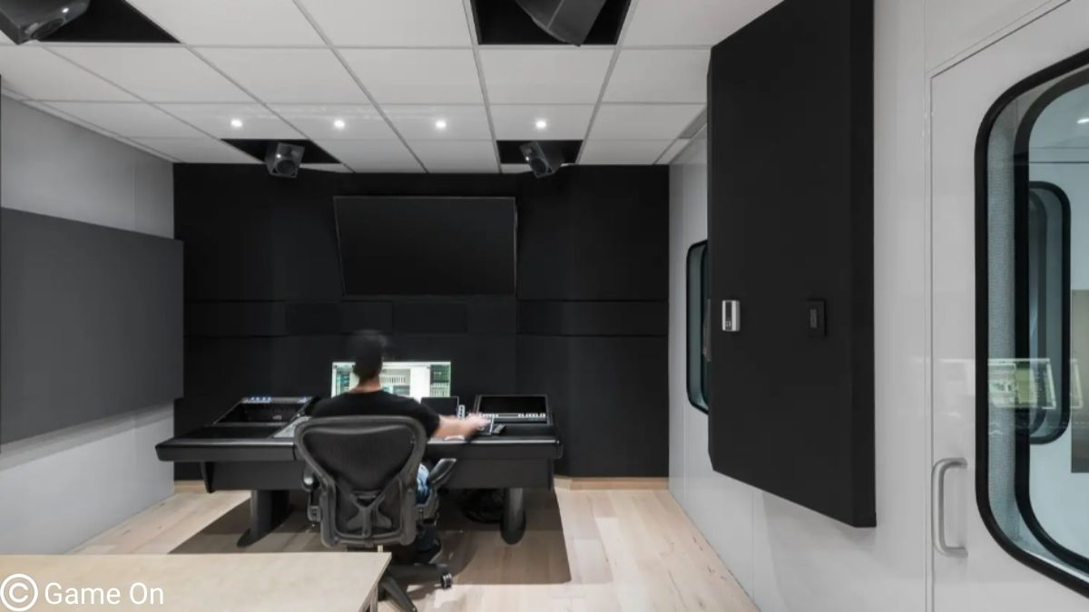
05
AUDIO & MUSIC
Sound Design
Adding immersive audio through sound effects, music systems, and dynamic mixing

Slide 23
Audio System Fundamentals
Two Primary Categories
Sound Effects (SFX)
Audio Architecture
Short, event-driven sounds played through AudioSource components.
AudioClip
AudioSource
Background Music (BGM)
AudioMixer
AudioListener
Continuous tracks setting mood. Loop seamlessly for uninterrupted play.
AudioMixer groups and processes audio with effects, volume control, and snapshots
Key Technical Concepts
Component | Description
AudioClip | The actual sound file asset (.wav, .mp3, .ogg)
AudioSource | Plays clips with volume, pitch, spatial settings
AudioListener | Receives all audio output (typically on camera)
Separate SFX and Music into different mixer groups.
23

Slide 24
Sound Effects Implementation
Four best practices for professional SFX implementation:
Pool AudioSources
Common Sound Triggers
1
Reuse sources instead of Instantiate per sound
● Footsteps — animation events
● Jump / Land — state change callbacks
● Shoot / Attack — input triggers
● Collect / Pickup — collision events
● UI Clicks — onClick handlers
● Damage / Death — health events
2
Add Variation
Pitch randomization and clip variants prevent fatigue
3
3D Spatial Audio
3D spatial blend with distance rolloff curves
// Pitch variation example
source.pitch = Random.Range(0.95f, 1.05f);
source.PlayOneShot(clip);
4
Trigger at Key Points
Play sounds at exact animation frames or event callbacks
24

Slide 25
Background Music & Dynamic Mixing
Music systems go beyond simple looping. Three professional techniques:
Crossfading
Layered Music
Adaptive Music
Smoothly transition between tracks by fading out current while fading in new over 1-2 seconds. Creates seamless mood shifts.
Compose in stems (drums, bass, melody). Mix layers dynamically based on game intensity — add percussion during combat.
Switch between calm, tension, and combat music via AudioMixer snapshots triggered by game state changes.
MusicManager Pattern
public class MusicManager : MonoBehaviour {
public void Crossfade(AudioClip clip,
float duration) { ... }
public void SetIntensity(float level) {
mixer.SetFloat("Intensity", level); }
}
Use a MusicManager singleton with PlayMusic(), CrossfadeTo(), and SetIntensity() methods.
Music should loop seamlessly with carefully edited loop points. Avoid pops or gaps at boundaries.
25

Slide 26
06
MORE LEVELS
Adding More Levels
Level progression, scene management, and scalable content architecture

Slide 27
Level Design Patterns
Difficulty Curve
Level Design Document
Progressively introduce challenges following an "easy ramp up, occasional dip" rhythm. Give players breathing room after hard sections.
Document each level's purpose:
● What does it teach?
New mechanic introduced
● What does it test?
Skills player must demonstrate
● How does it connect?
Progression to next level
Teaching Through Design
Each level introduces one new mechanic in a safe environment before combining it with previous mechanics.
Checkpoints & Respawns
Frequent checkpoints reduce frustration and maintain flow. Place them after challenging sections as a reward.
Secret Areas
Optional challenges reward exploration with collectibles or shortcuts
27

Slide 28
Scene Management & Level Loading
Loading Approaches
Scene Architecture
Single Scene Per Level
Each level is a separate scene file. Load with SceneManager.LoadScene().
Bootstrap (Managers)
Additive Loading
Menu Scene
Load levels additively for seamless open worlds.
async
Level 1, 2, 3...
Best Practices
● Use asynchronous loading (LoadSceneAsync) with a loading screen
Bootstrap scene loads first and persists. Managers use DontDestroyOnLoad().
● Preload shared assets in a persistent bootstrap scene
● Use DontDestroyOnLoad for managers that survive scene changes
● Show a progress bar using AsyncOperation.progress
28

Slide 29

07
CODE BASICS
Code Architecture
Essential programming patterns for clean, maintainable game code

Slide 30
Core Programming Patterns
Five essential patterns every game developer should master:
01
Singleton
02
Observer Pattern
03
Component Pattern
One global instance of managers. Use sparingly to avoid tight coupling.
Event-driven communication. C# events and delegates decouple systems.
Entities are containers of behaviors. Mix and match for flexibility.
04
State Machine
05
Object Pooling
Manage entity behaviors and game flow with discrete states and defined transitions. Prevents invalid state changes.
Reuse GameObjects instead of Instantiate/Destroy. Eliminates garbage collection spikes during gameplay.
Mastering these patterns produces code that is modular, testable, and scalable as your projects grow from prototypes to full games.
30

Slide 31
Code Organization Best Practices
Folder Organization
Naming Conventions
Performance Tips
Scripts/
├── Managers/
├── Gameplay/
├── UI/
├── Entities/
└── Utilities/
● PascalCase — classes, methods
PlayerController, Start()
● camelCase — variables
playerSpeed, isGrounded
● ALL_CAPS — constants
MAX_HEALTH, GRAVITY
● Cache references in Awake/Start
● Use Coroutines for timed ops
● Avoid FindObjectOfType in Update
● Use object pools for particles
● Profile early, profile often
Version Control
Code Comments
● Commit frequently with meaningful messages
● Use feature branches — branch per feature, merge when complete
● XML documentation for public APIs
● Inline comments only for complex logic
Clean code is not about perfection — it is about making code understandable for your future self and teammates.
31

Slide 32
KEEP BUILDING
"The best way to learn game programming is to make games.
Start small, finish projects, and build your skills one level at a time."
Game Programming — Week 6 — Spring 2026

